Slide 1
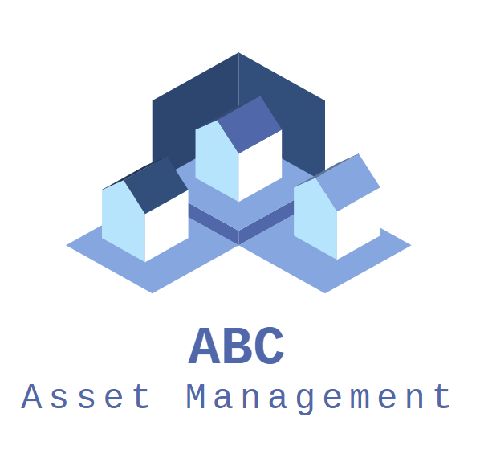
Fund Fact Sheet Generator
Notes:
Hello and welcome to the presentation for our Fund Fact Sheet Generator for ABC asset management

Slide 2

Agenda
Process Overview
C# App & Fact Sheet Generator Demo on UiPath
Requirements Checklist
Q&A, Code Review & Documentation Review
Notes:
For today’s agenda, I will be going through the brief process overview of how the app will work. This is to give a clearer context while we are looking at the demo. Then, we will run the demo, going through the web app first followed by the UiPath scrapping. Afterwards, we will go through the requirements checklist to see which requirements are met or still working in progress. Finally, we will have a Q&A session to wrap it up.

Slide 3
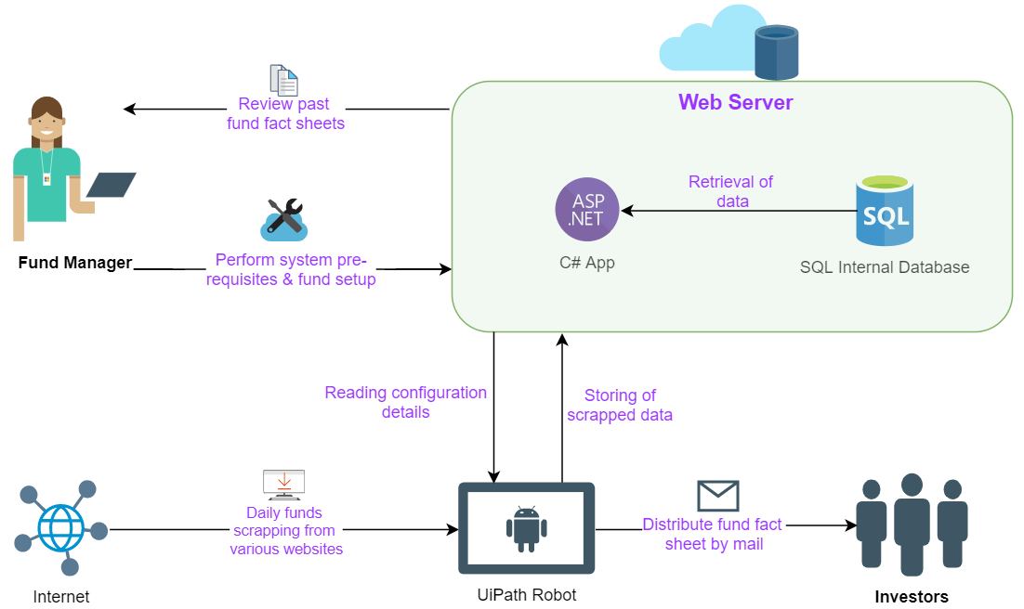
Process Overview
Notes:
For the process overview, our solution comprises of a two pronged approach, the first comprise of a web app that allows the fund manager to configure any fund details and also look through past fund fact sheet. The second part we will be using UiPath automation to scrap the daily funds for various stocks.

Slide 4
Web App & Fact Sheet Generator Go-Live
Notes:
Without further ado, let us present how this will work

Slide 5
Requirements Checklist
Requirement | Progression | Workaround
Login/Logout | Completed
Main | Completed
Search Fact Sheet | Completed
Edit Company’s Info | Completed
Edit Fund Details | Completed
Edit Investor List | Completed
Update Schedule | Partial Completion | 1) Windows Scheduler 2) 1 day course on orchestrator 3) Run the orchestrator every hour to get the schedule
Daily Scrapping | Completed
Generate Fact Sheet | Completed
Send Email | Completed
Funds Rebalancing | Working in Progress
Agenda
Notes:
1. Scheduling from app not met, workaround, run it every hour (not practical, especially considering that with more and more people using concurrent licensing, running the bot every hour is a waste of time), offer a free 1 day lesson on orchestrator
2. 1 min/ 2-3 min, 5 min for rebalancing

Slide 6
Q&A
Notes:
For today’s agenda, I will be going through the brief process overview of how the app will work. This is to give a clearer context while looking into the demo. Then, we will run the demo, going through the c# app first and then the UiPath scrapping. Afterwards, we will go through the requirements checklist to see which requirements are met or working in progress. Finally, we will have a Q&A session.

Slide 7
Thank You
UST Global Team 1
Notes:
Show email

